Slide 1

Building Upgrade Consultation Presentation
November 2020

Slide 2
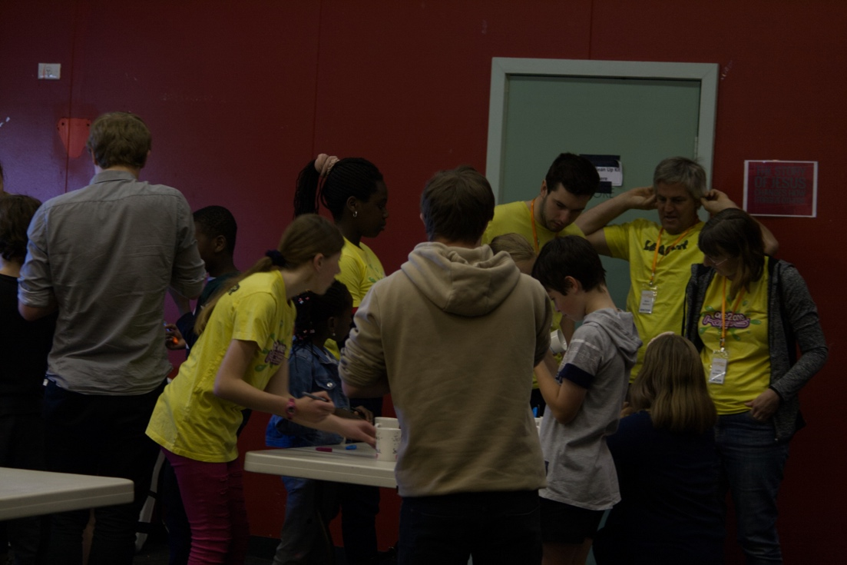
Purpose
To communicate the exciting plans the church has to upgrade our facilities
Undertake consultation process for Phase 1
If you have any further questions or feedback, please contact Peter Stickland at peter@churchone2one.org.au.
Join us for a facilities workshop via zoom on Tuesday 17th November at 7.30pm
Link to the Zoom Meeting
Add images here

Slide 3
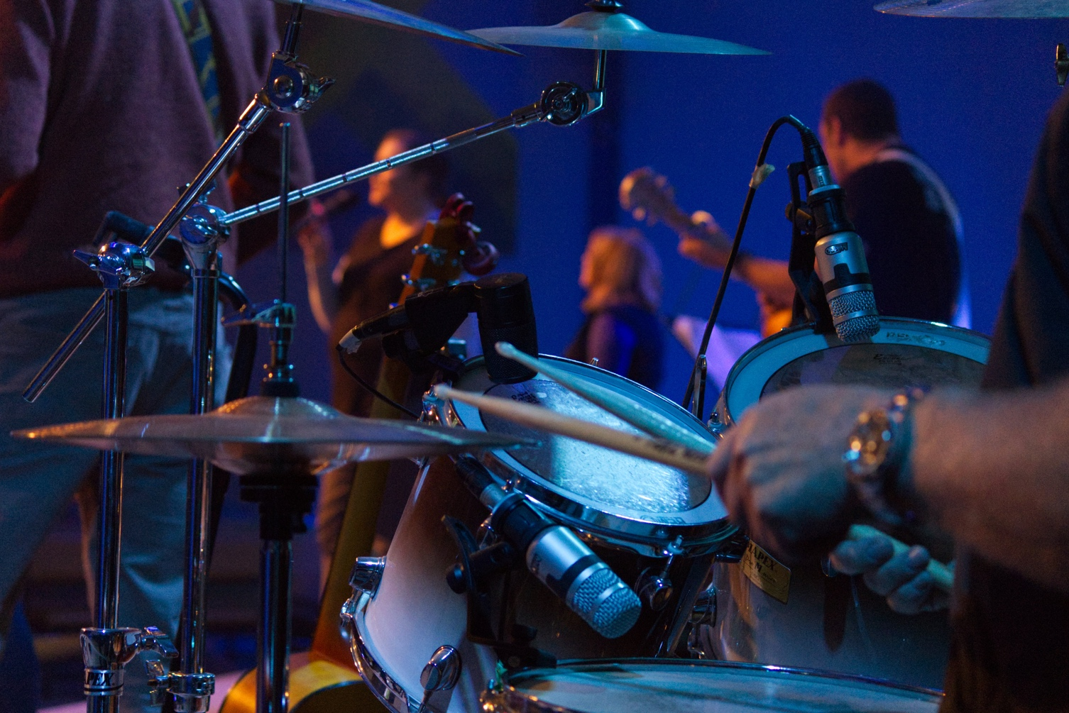
Background
one2one has done an amazing job at adapting a building that wasn’t meant to be a church into a place where great ministries take place and significant growth in God’s kingdom have occurred
Add images here

Slide 4
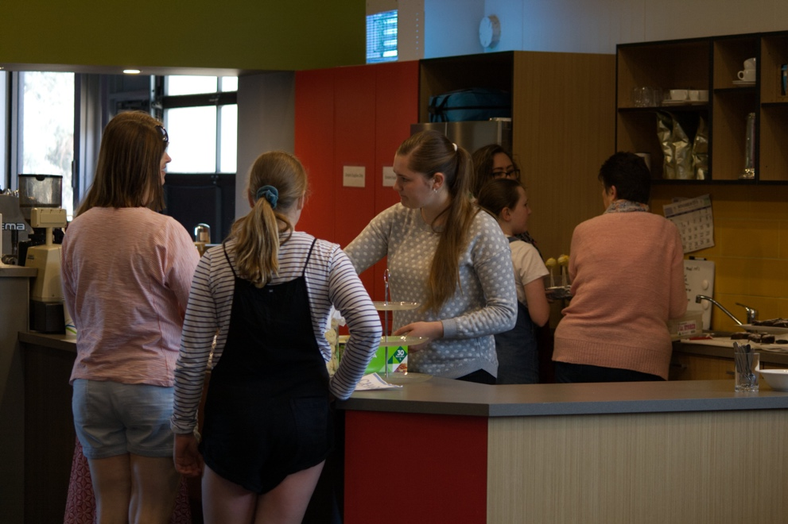
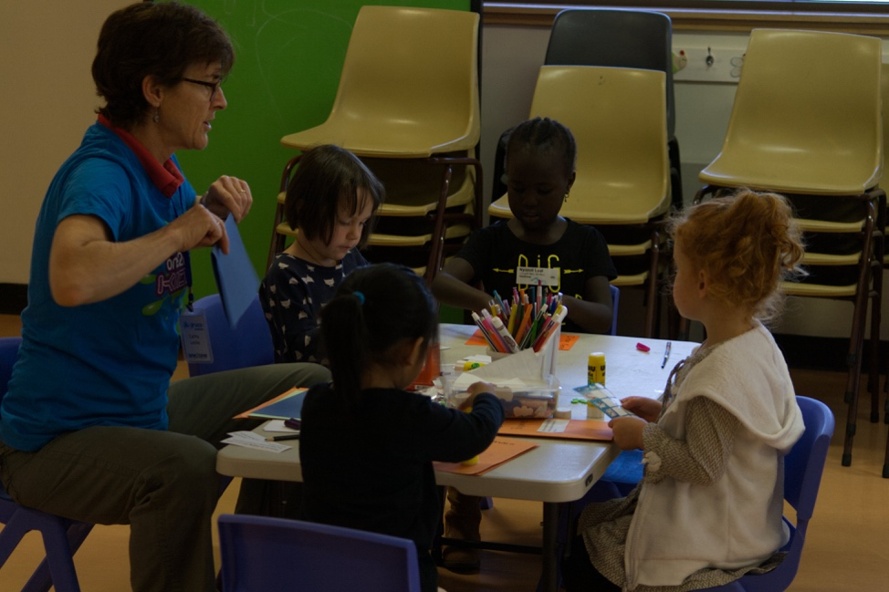
Vision: Reach, Renew, Release
The building team has been tasked with identifying what changes need to be made to our facilities so they can support achieving our vision
In particular we want to:
  Enable a focus on ministries to kids and families
  Enable overall Sunday attendance to grow to 800
Add images here

Slide 5
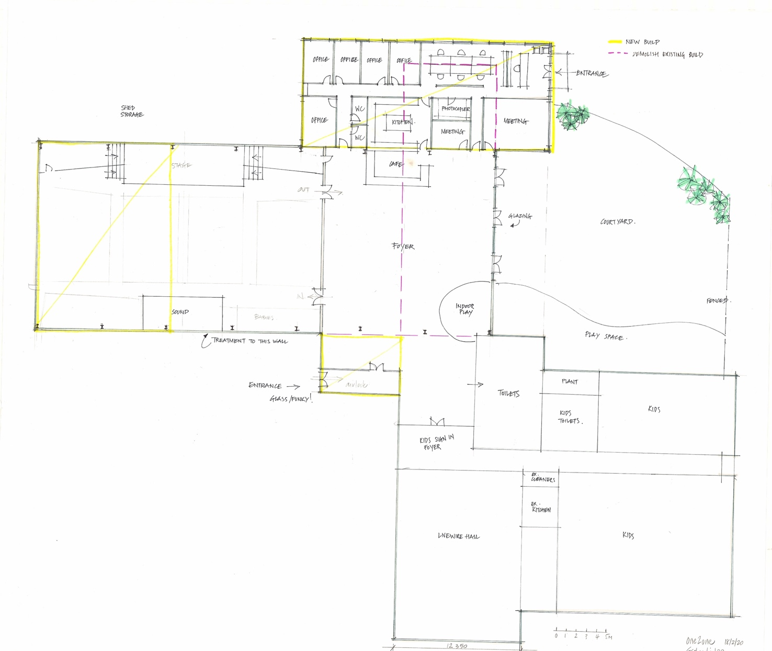
Endorsed Master Plan
Key upgrades needed for our current building:
A larger, dedicated kids ministry space (including kids-only toilets)
Upgrade the adults toilets
Increasing the size of our foyer space
To enable Sunday attendance to 800 also need:
Increase the size of our auditorium
Upgrade our kitchen facilities
Multiple options considered
Fine-tuned from initial 2019 Master Plan
Office:
230m²
Bigger Foyer:
440m²
Courtyard
Auditorium
extension:
=> 520m²
~475 seats
Adults
toilets
Entrance
Kids
toilets
Kids/Youth expanded:
560m²

Slide 6
Phasing of Master Plan
Phase 3:
Expand Kids min
New office
Kitchen
landscaping
Important that the masterplan can be phased, with the highest priority areas addressed first.
The masterplan can be implemented in three phases:
  Phase 1: foyer enhancements, larger and dedicated kids ministry area and improving toilet and kitchen facilities
  Phase 2: increasing foyer space, including an improved entrance and enhancements to auditorium
  Phase 3: further increase kids/youth ministry area by moving the office area and a new kitchen and landscaped northern courtyard.
Office:
230m²
Bigger Foyer:
440m²
Courtyard
Auditorium
extension:
Adults
toilets
Kids
toilets
Phase 2:
Extend auditorium & foyer
Auditorium fit out
Entrance
Entrance
Phase 1:
New toilets,
kids min modifications
Foyer enhancement
Kids:
560m²

Slide 7
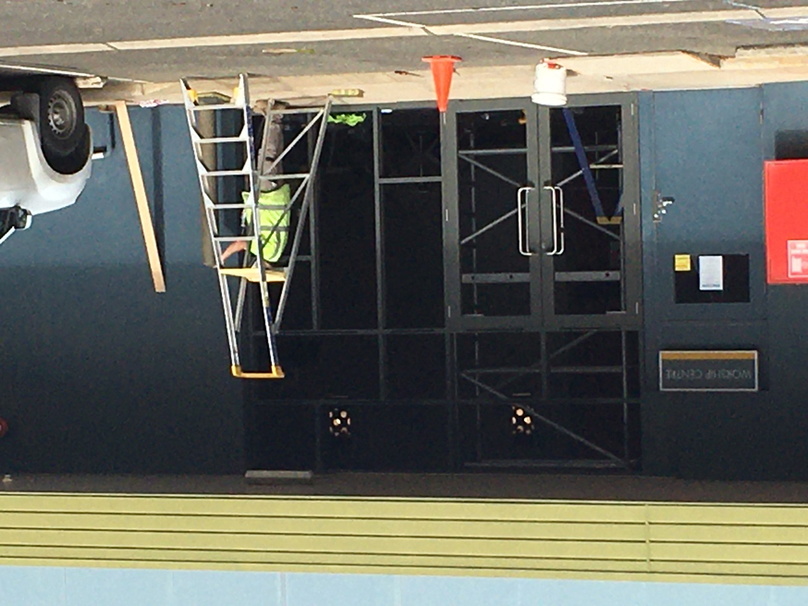
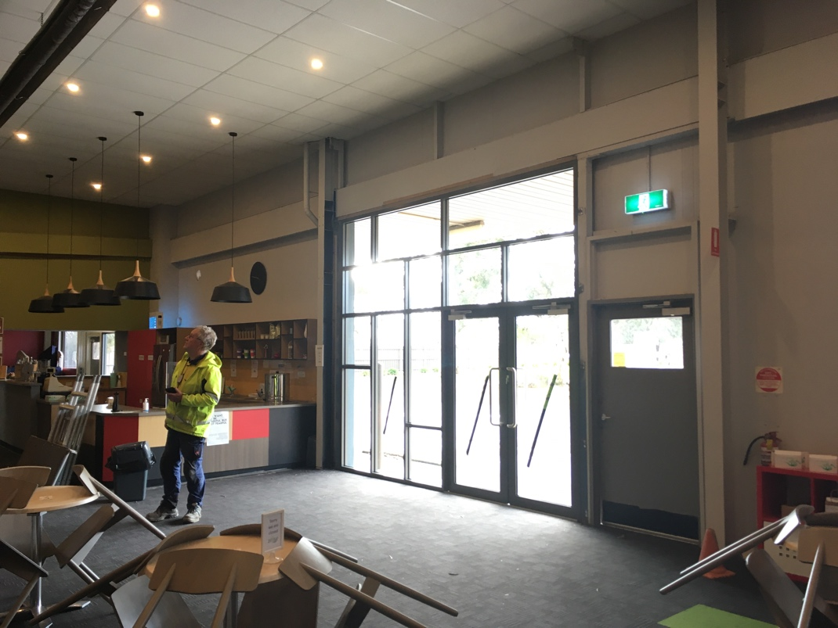
Phase 1: New windows/doors in Foyer
Already completed!
improves light in foyer and connection to north carpark

Slide 8
Phase 1: Overview
New kids/youth room
  internal folding wall
Livewire hall
  increase the storage capacity
  new stage
New Creche
Smaller office space
Adult Female toilets
Toilets
  Separate and better facilities for both adults and kids.
  Enables a dedicated kids/youth-only ministry area on Sunday morning
Increase Kitchen size by ~50%
Entrance
Glo-group Room
Adult male toilets
Creche
Dedicated children’s toilets
New Kids/ Youth room
Smaller open plan office area
Livewire Hall
Retain offices along East wall
New storage

Slide 9
Phase 1: Compress Office & Expand kids space
Increase the amount and quality of space available for kids and youth ministry
Achieved by compressing the current open-plan office to build a large new room behind kitchen.
  Multi-purpose
  internal concertina wall
  accessible both from the main corridor and directly from the livewire hall.
New Kids/ Youth space with internal folding wall
Smaller open plan office area
Retain existing offices along East wall

Slide 10
Phase 1: Upgrade livewire hall
Make more effective by
increasing the storage capacity along the east side of the room
installing a new stage with better technical equipment on the south wall.
Orientate livewire towards stage on south wall
New storage

Slide 11
Phase 1: Kitchen upgrade
Kitchen extended by ~50%
Some significant enhancements to our current kitchen.
  Increase size by ~50%
  New stove
  More storage and preparation space
Full kitchen replacement anticipated in Phase 3
Livewire
New Kids & Youth room
Offices

Slide 12
Phase 1: New Toilets
Separate and better facilities for both adults and kids.
Enables a dedicated kids/youth-only ministry area on Sunday morning
Main Entrance
Adult Female toilets
Adult male toilets
Dedicated children’s toilets
Dedicated kids/youth ministry area on Sunday

Slide 13
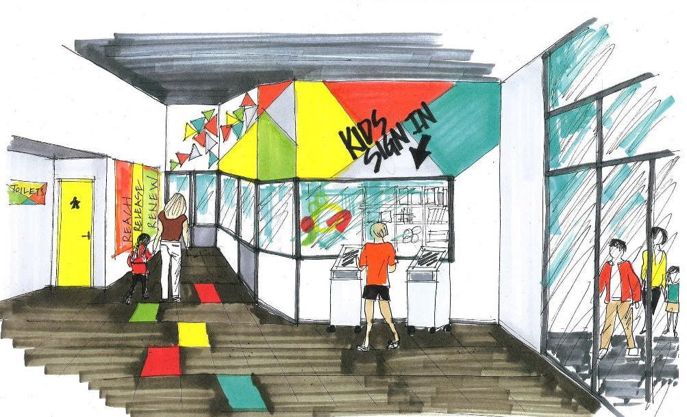
Phase 1: Kids sign-in area & creche
New creche room in area now occupied by current library and livewire storeroom.
  Bigger
  Better natural light
  Internal windows so parents can peek in on their kids.
Sign-in area for kids/youth ministries enhanced with wider doorways.

Slide 14
Conclusion & Next Steps
The building team is currently working on scoping Phase 1
Has the potential to be completed in less than 12 months and at moderate costs.
Currently undertaking wider consultation with the congregation
Next steps:
  Consolidate plans based on feedback from the congregation
  confirm planning and regulatory requirements
A decision on whether to proceed with Phase 1 is expected around the end of 2020.
We are at an exciting stage in this process and would really value your feedback on our current plans so that they can be finetuned

